Slide 1
Chapter 2: BJT and its applications
Module 1 : BJT Characteristics
Reference: Robert L. Boylestad, Louis Nashelsky, Electronic Devices & Circuits Theory, 11th Edition, PHI, 2012

Slide 2
At the end of this module, students will be able to:
Discuss the operation of Bipolar Junction Transistor.
Draw Common Base and Common Emitter configuration of transistor.
Explain input and output characteristics of Common Base and Comon Emitter Configurations of transistor.
Derive expressions for current gains in transistor.

Slide 3
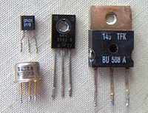
Available packages

Slide 4
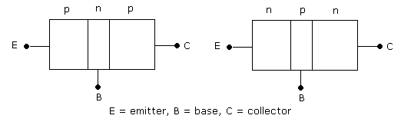
Introduction
3 terminal , 2 junction device
Types of Transistors → NPN Transistor
→ PNP Transistor

Slide 5
3 terminals → Emitter, Base, Collector 2 junctions → Emitter-Base junction, Collector-Base junction Emitter is heavily doped. Collector is moderately doped. Base is lightly doped.
NPN→Emitter and Collector are N-type
Base is P-type
PNP→Emitter and Collector are P-type
Base is N-type

Slide 6
Transistor Symbol
NPN Transistor PNP Transistor
NPN Transistor PNP Transistor
Arrow head indicates direction of current
Current is due to both free electrons and holes

Slide 7
Modes of operation
Mode | Emitter-Base Junction | Collector-Base Junction
Cut-Off | Reverse Biased | Reverse Biased
Active | Forward Biased | Reverse Biased
Reverse Active | Reverse Biased | Forward Biased
Saturation | Forward Biased | Forward Biased

Slide 8
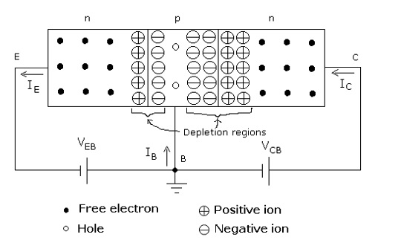
Working of an NPN Transistor

Slide 9
Emitter-Base junction forward biased, Collector-Base junction reverse biased
Free electrons from emitter drift towards base region
Some free electrons recombine with holes in base region to form small base current
Inside base region(P-type), free electrons are minority carriers.
Most of the free electrons are swept away to collector region due to reverse biased CB junction

Slide 10
Currents in BJT
Emitter Current → Due to the flow of free electrons from emitter to base region. Results in a current from base to emitter
Base Current →Due to the recombination of free electrons and holes in the base region. Very small magnitude
Collector Current → One, due to the injected free electrons from base region to collector. Other, due to thermally generated minority charge carriers

Slide 11
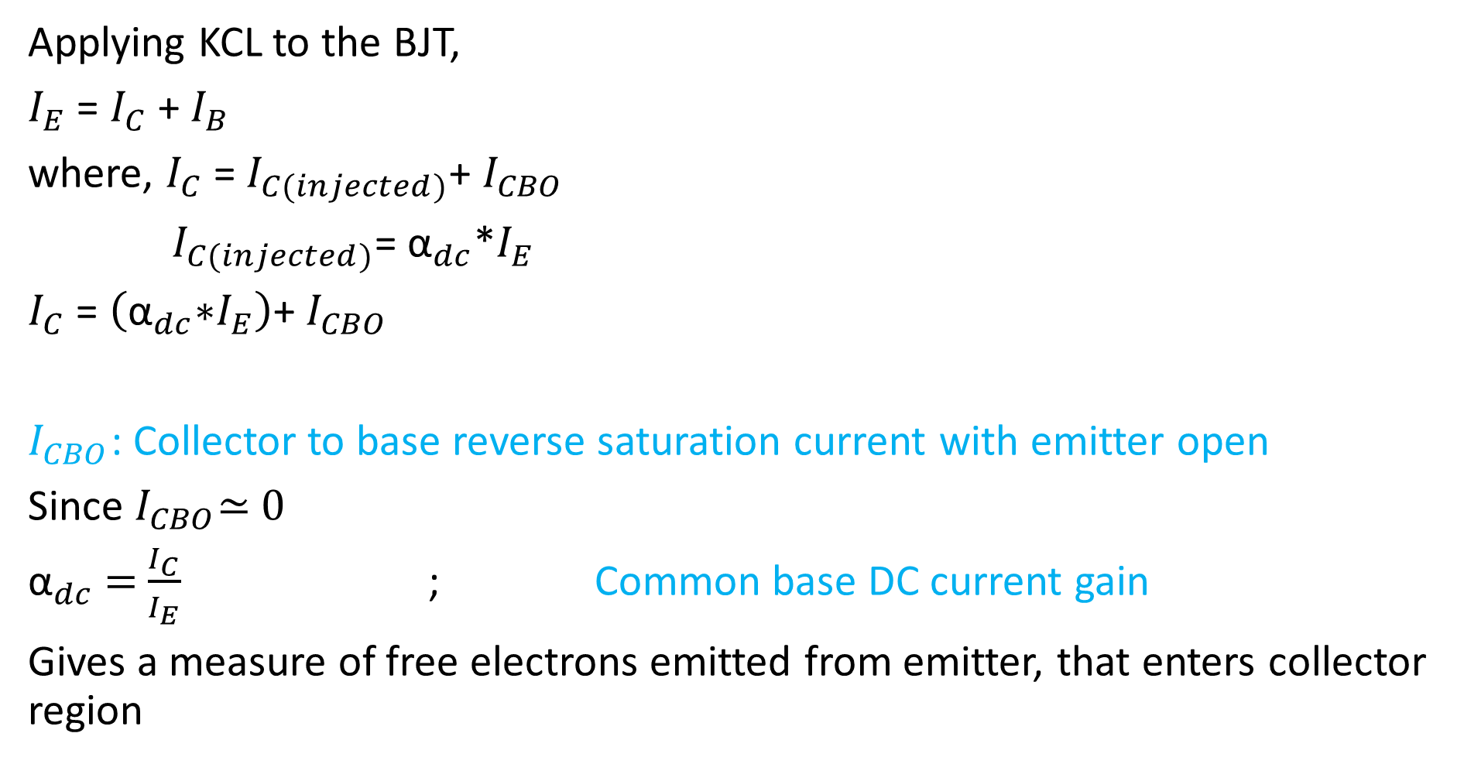
Applying KCL to the BJT,
$I_{E}$ = $I_{C}$ + $I_{B}$
where, $I_{C}$ = $I_{C(injected)}$+ $I_{CBO}$
$I_{C(injected)}$= ${\text{α}}_{dc}$*$I_{E}$
$I_{C}$ = $\left({\text{α}}_{dc}\text{∗}I_{E}\right)$+ $I_{CBO}$
$I_{CBO}$: Collector to base reverse saturation current with emitter open
Since $I_{CBO}$≃ 0
${\text{α}}_{dc}$ = $\frac{I_{C}}{I_{E}}$ ; Common base DC current gain
Gives a measure of free electrons emitted from emitter, that enters collector region

Slide 12

Typically ${\text{α}}_{dc}$ ≃ 0.99
Like in diode, reverse saturation current $I_{CBO}$ doubles for every ${10}^{0}$C rise in temperature
$I_{C}$ = $\left({\text{α}}_{dc}\text{∗}I_{E}\right)$+ $I_{CBO}$ and $I_{E}$ = $I_{C}$ + $I_{B}$
→ $I_{C}$ = ${\text{α}}_{dc}\text{∗}\left(I_{C}\text{ + }I_{B}\right)$+ $I_{CBO}$
→ $I_{C}$ =${ \text{α}}_{dc}I_{C}$ + ${\text{α}}_{dc}I_{B}$ +${ I}_{CBO}$

Slide 13
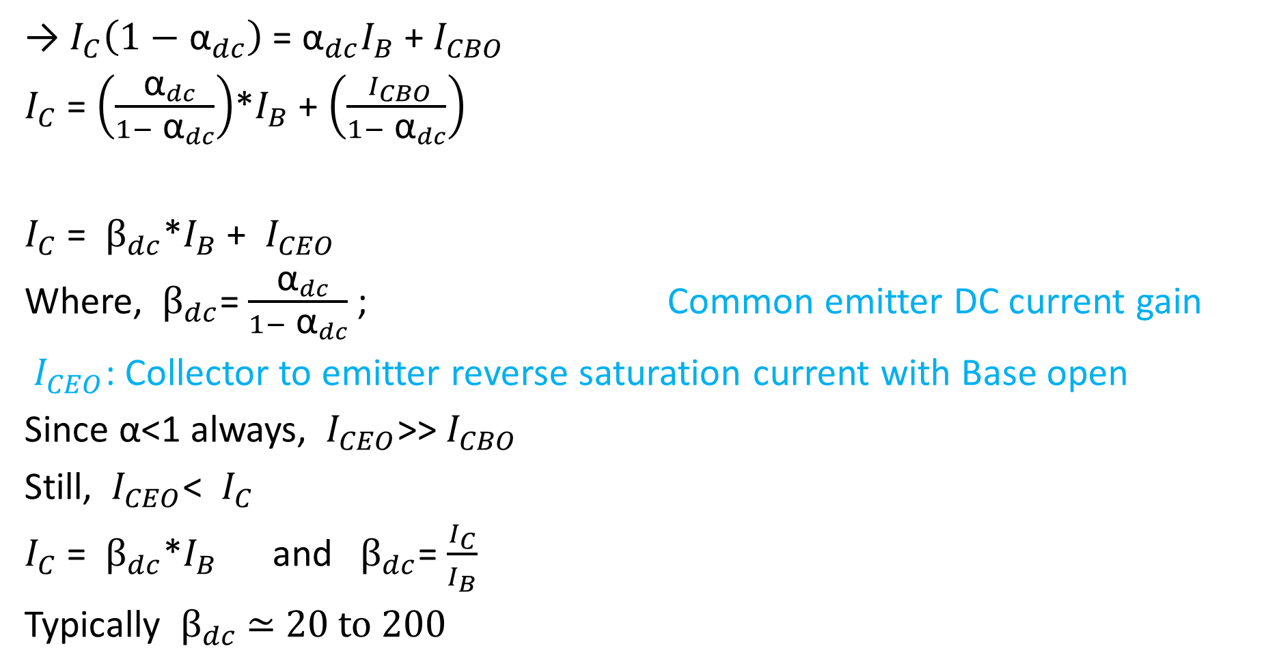
→ $I_{C}\left(1−{ \text{α}}_{dc}\right)$ = ${\text{α}}_{dc}I_{B}$ +${ I}_{CBO}$
$I_{C}$ = $\left(\frac{{ \text{α}}_{dc}}{1−{ \text{α}}_{dc}}\right)$*$I_{B}$ + $\left(\frac{{ I}_{CBO}}{1−{ \text{α}}_{dc}}\right)$
$I_{C}$ = ${ β}_{dc}$*$I_{B}$ + ${ I}_{CEO}$
Where, ${ β}_{dc}$= $\frac{{ \text{α}}_{dc}}{1−{ \text{α}}_{dc}}$ ; Common emitter DC current gain
${ I}_{CEO}$: Collector to emitter reverse saturation current with Base open
Since α<1 always, ${ I}_{CEO}$>>${ I}_{CBO}$
Still, ${ I}_{CEO}$< ${ I}_{C}$
$I_{C}$ = ${ β}_{dc}$*$I_{B}$ and ${ β}_{dc}$= $\frac{I_{C}}{I_{B}}$
Typically $β_{dc}$ ≃ 20 to 200

Slide 14
BJT Configurations
BJT has three terminals
Accordingly three configurations exist
Common Base (CB) configuration
Common Emitter (CE) configuration
Common Collector (CC) configuration

Slide 15

Q1. A BJT has ${ \text{α}}_{dc}$= 0.998 and collector-base reverse saturation current of 1µA. If emitter current is 5mA, what is the value of $I_{C}$ and $I_{B}$?
$I_{C}$ = $\left({\text{α}}_{dc}\text{∗}I_{E}\right)$+ $I_{CBO}$
→$I_{C}$ = 4.991mA
$I_{E}$ = $I_{C}$ + $I_{B}$
→ $I_{B}$= 9µA

Slide 16
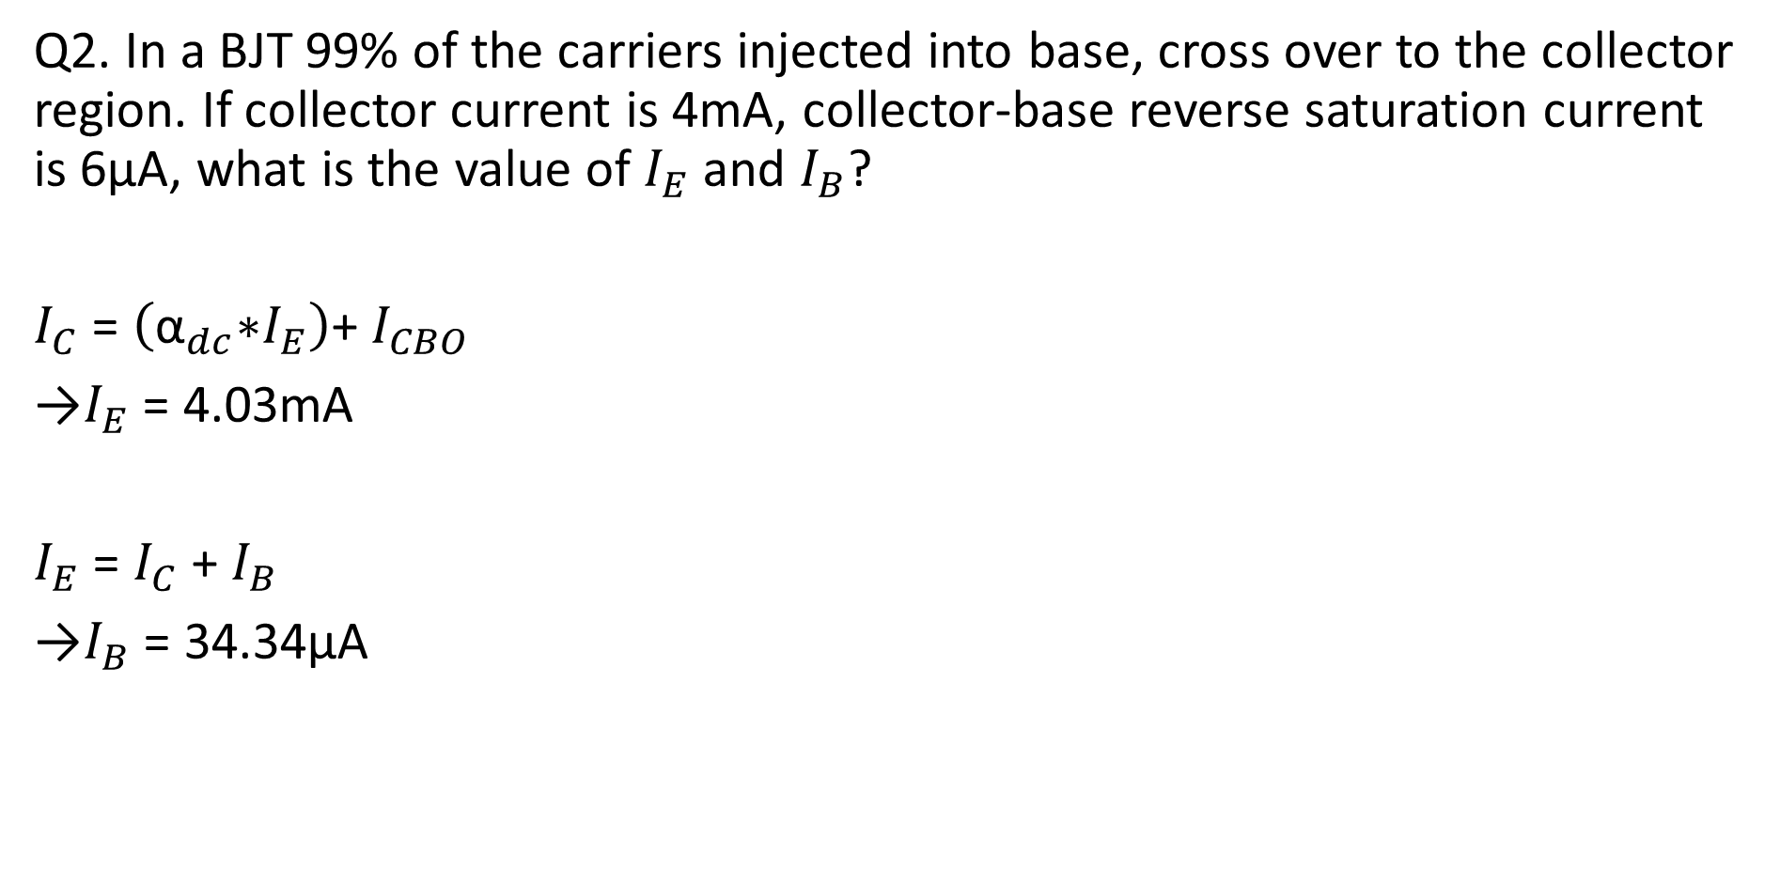
Q2. In a BJT 99% of the carriers injected into base, cross over to the collector region. If collector current is 4mA, collector-base reverse saturation current is 6µA, what is the value of $I_{E}$ and $I_{B}$?
$I_{C}$ = $\left({\text{α}}_{dc}\text{∗}I_{E}\right)$+ $I_{CBO}$
→$I_{E}$ = 4.03mA
$I_{E}$ = $I_{C}$ + $I_{B}$
→$I_{B}$ = 34.34µA

Slide 17
Q3. An NPN transistor has collector current 4mA and base current 10 μA. Calculate the alpha and beta values of the transistor, neglecting the reverse saturation current I_{CBO.} (Ans: 0.9975, 400)

Slide 18
Q4. In a transistor circuit, when the base current is increased from 0.32 mA to 0.48 mA, the emitter current increases from 15 mA to 20 mA. Find α_{ac} and β_{ac} values. (Ans: 0.968, 30.25)

Slide 19
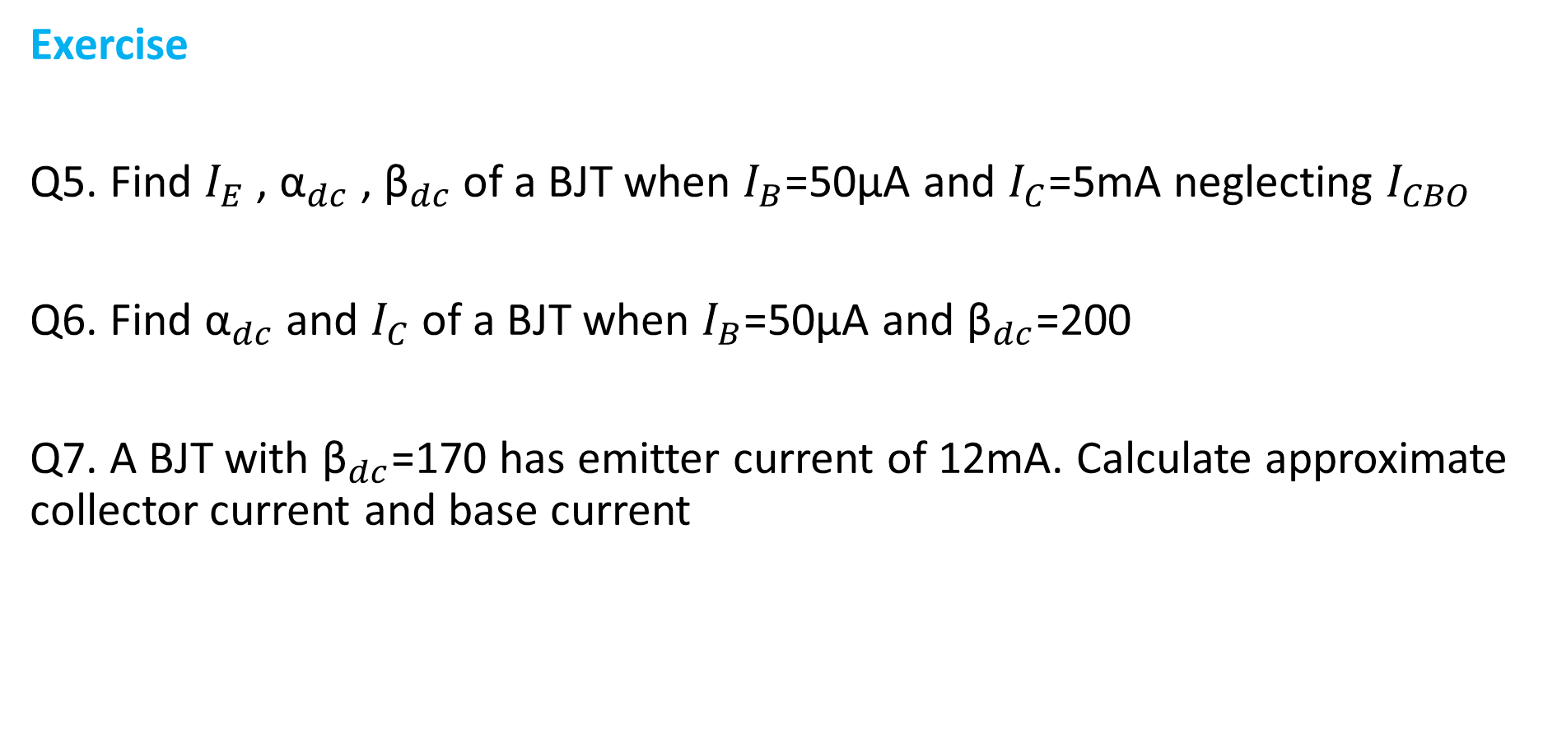
Exercise
Q5. Find $I_{E}$ , ${\text{α}}_{dc}$ , ${\text{β}}_{dc}$of a BJT when $I_{B}$=50µA and $I_{C}$=5mA neglecting $I_{CBO}$
Q6. Find ${\text{α}}_{dc}$ and $I_{C}$ of a BJT when $I_{B}$=50µA and ${\text{β}}_{dc}$=200
Q7. A BJT with ${\text{β}}_{dc}$=170 has emitter current of 12mA. Calculate approximate collector current and base current

Slide 20

Relation between α and β
$I_{E}$ = $I_{C}$ + $I_{B}$
$\frac{I_{E}}{I_{C}}$ = $\frac{I_{C}}{I_{C}}$ + $\frac{I_{B}}{I_{C}}$
$\frac{1}{{\text{α}}_{dc}}$ = 1+ $\frac{1}{{\text{β}}_{dc}}$
${\text{α}}_{dc}$ = $\frac{{\text{β}}_{dc}}{1+{\text{β}}_{dc}}$ ${\text{β}}_{dc}$= $\frac{{\text{α}}_{dc}}{1+{\text{α}}_{dc}}$
c
c

Slide 21
I/O Characteristics
α and β alone does not explain the characteristics of a BJT
Other traits can be obtained from curves that relate current and voltage. These curves are called Characteristic Curves
In general,
Input characteristics:
Relation between input voltage and input current keeping output voltage constant
Output characteristics:
Relation between output voltage and output current keeping input current constant

Slide 22
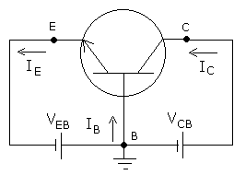
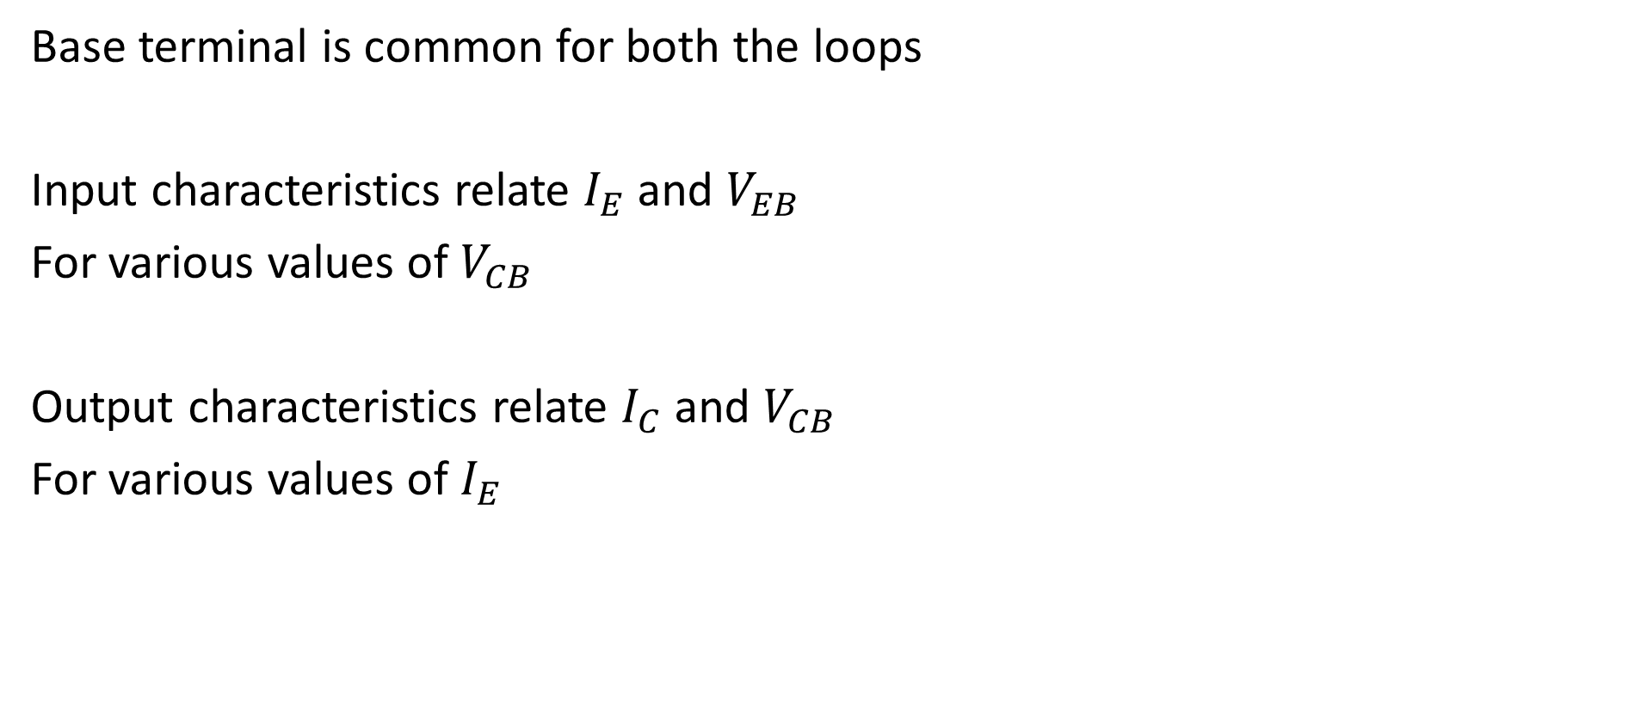
Common Base Configuration
Base terminal is common for both the loops
Input characteristics relate $I_{E}$ and $V_{EB}$
For various values of $V_{CB}$
Output characteristics relate $I_{C}$ and $V_{CB}$
For various values of $I_{E}$

Slide 23
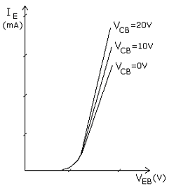
CB Configuration Input characteristics:
A plot of I_{E} versus V_{EB}
for various values of V_{CB.}

Slide 24
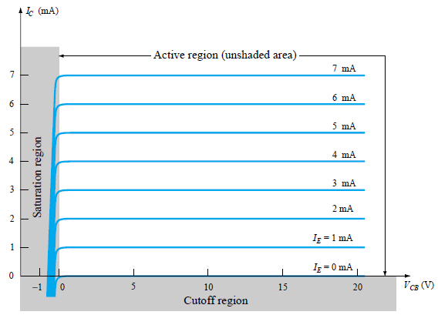
CB Configuration Output characteristics:
A plot of I_{C} versus V_{CB}
for various values of I_{E.}

Slide 25
3 Regions operation
Saturation Region:
Located to the left of V_{CB} =0.
CB junction is forward biased.
Small change in V_{CB} results in large change
in I_{C}

Slide 26
Active Region:
Located to the right of V_{CB} =0.
(unshaded area)
EB junction is forward biased.
CB junction is reverse biased.
I_{C} is almost constant for given I_{E} and nearly equal to I_{E}
I_{C} increases slightly with increase in V_{CB} due to BASE WIDTH MODULATION

Slide 28
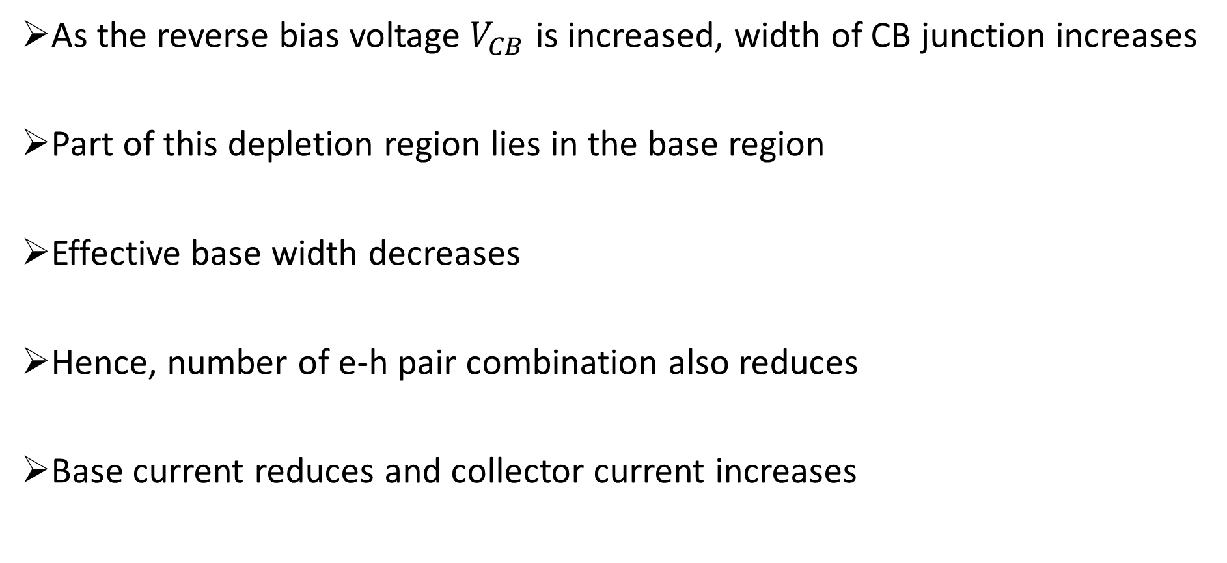
Base Width Modulation
As the reverse bias voltage $V_{CB}$ is increased, width of CB junction increases
Part of this depletion region lies in the base region
Effective base width decreases
Hence, number of e-h pair combination also reduces
Base current reduces and collector current increases

Slide 29
Cutoff Region:
Located below the line corresponding to
I_{E} =0
Both EB & CB junctions are reverse biased.
A small collector current I_{C} = I_{CBO}
flows even when V_{CB} =0.

Slide 30
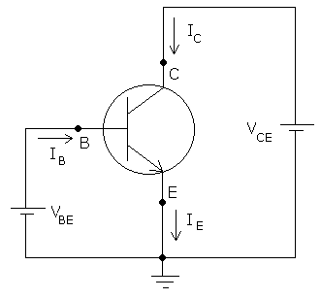
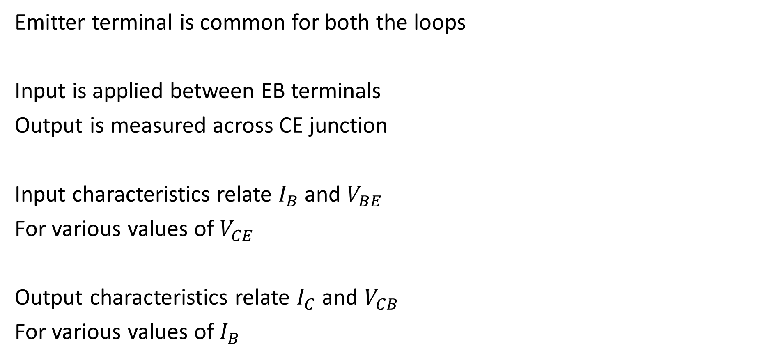
Common Emitter Configuration
Emitter terminal is common for both the loops
Input is applied between EB terminals
Output is measured across CE junction
Input characteristics relate $I_{B}$ and $V_{BE}$
For various values of $V_{CE}$
Output characteristics relate $I_{C}$ and $V_{CB}$
For various values of $I_{B}$

Slide 31
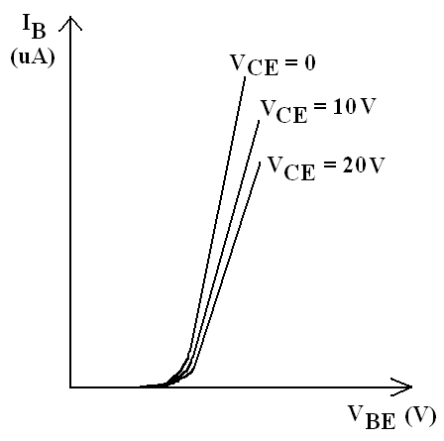
CE Configuration Input characteristics:
A plot of I_{B} versus V_{BE}
for various values of V_{CE.}

Slide 32
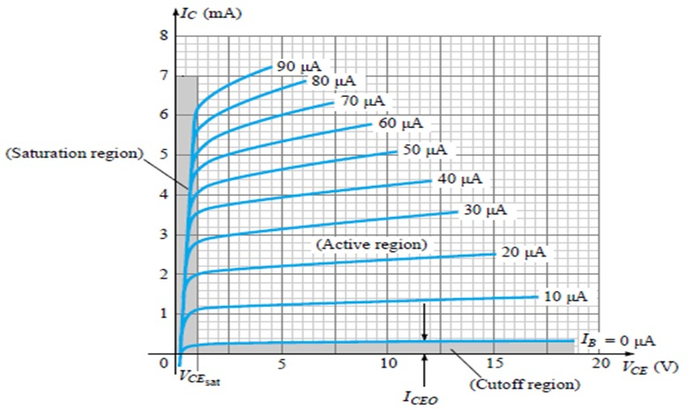
CE Configuration Output characteristics:
A plot of I_{C} versus V_{CE}
for various values of I_{B.}

